Slide 1
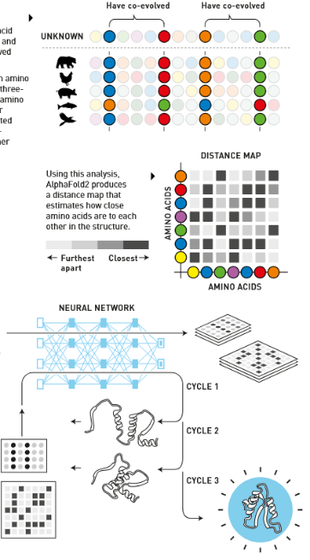
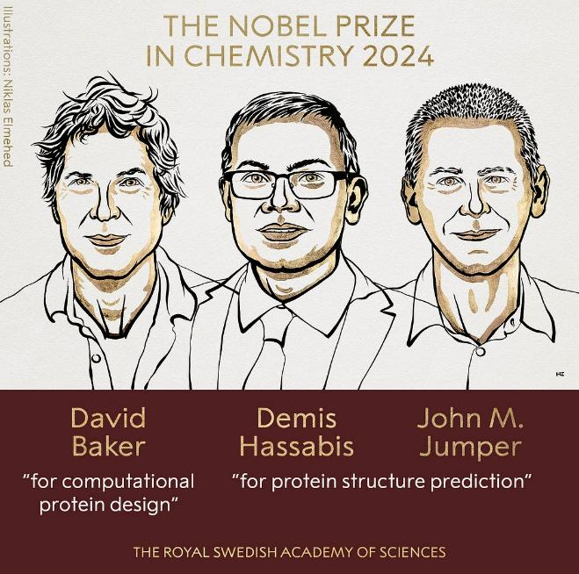
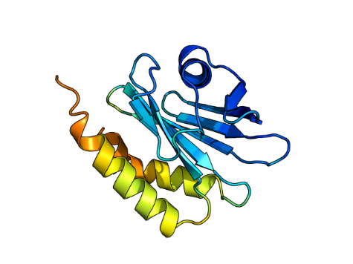

BABS2011- Current Trends in Biotechnology – Dr Keiran Rowell – March 21st 2025
Protein Structure Prediction
Source: https://www.nobelprize.org/prizes/chemistry/2024/press-release/

Slide 2
Tutorial structure Q&A (a few mins) between each section (yellow slides)
How did we get here? – 30 mins
A quick history of protein structure folding – how did we get to AlphaFold?
Looking under the hood – roughly how does AlphaFold work
An explosion of code choice – awareness of 'right tool' for the job
Biotech applications, and access – 30 mins
Folding all proteins in an organism
Resolving previously unsolved crystal structures
Building previously unseen giant assemblies
Access methods - licence restrictions on code
Break! 💤 – 10 mins ​
Do it yourself – 1 hr
Running AlphaFold2 in a Google Colab notebook
Live demo – 30 mins
ProteinFold – X'Fold' on a high performance computer terminal
On-Demand ProteinFold – automated webform through UNSW's Katana OnDemand

Slide 3
A brief history..

Slide 4

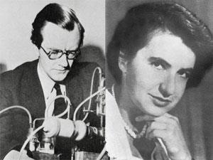
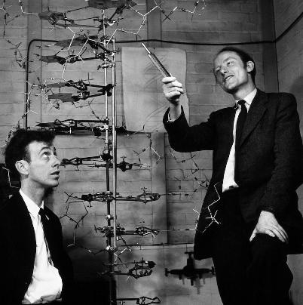
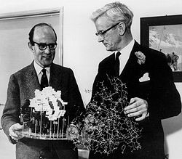
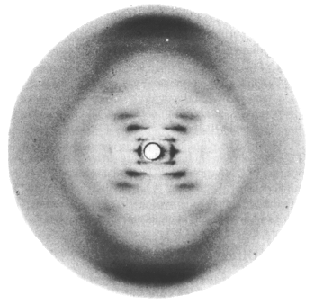
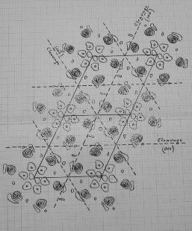
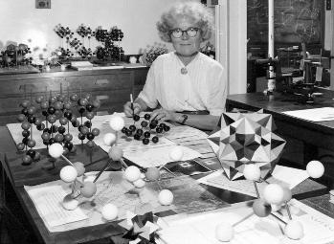
Models in Chemical Biology - function follows chemical form
Schrödinger speculates on
the molecules of life 1944
Perutz & Kendrew's model of the 3D structure of a protein (myoglobin) 1957 ​
Watson & Crick's DNA double-helix model 1953
Wilkins & Fraklin's X-ray diffraction images of DNA 1953
Kathleen Lonsdale resolves the structure of benzene 1924

Slide 5
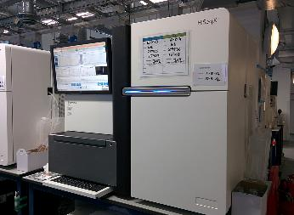
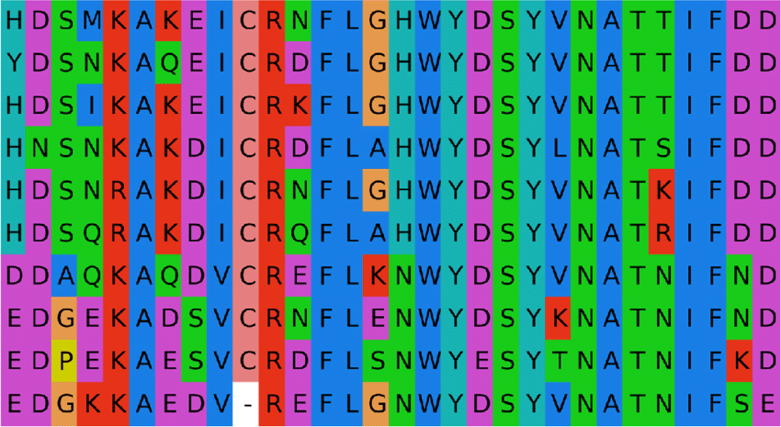
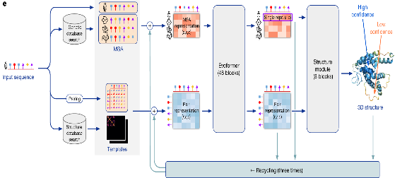
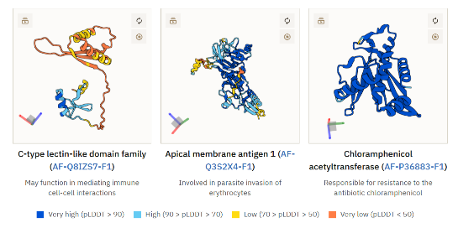
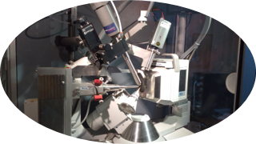
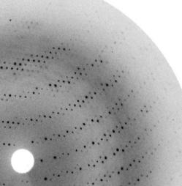
Deep Learning trained on experimental data
From genetic sequence
To modelled structure prediction
via computer
From protein
structure
Source: https://www.ebi.ac.uk/training/online/courses/alphafold/inputs-and-outputs/evaluating-alphafolds-predicted-structures-using-confidence-scores/plddt-understanding-local-confidence/

Slide 6
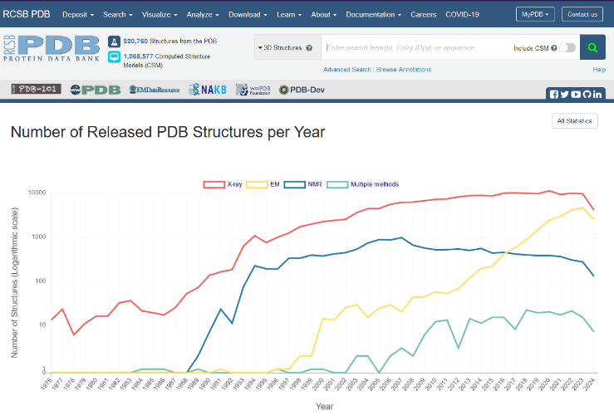
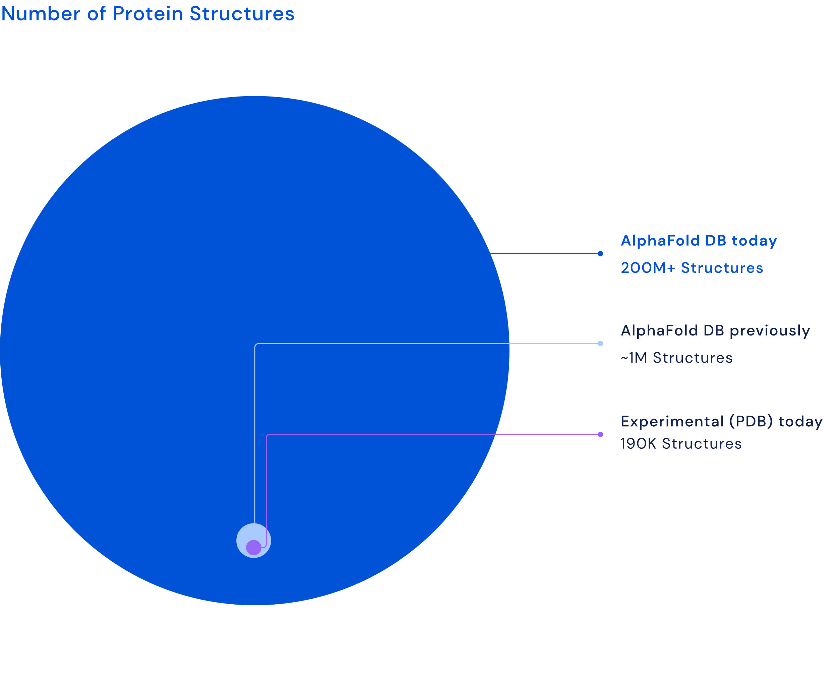
X-rays ruled 20thC – CryoEM & Calcs the 21st
Protein Data Bank (PDB)
Compute power – Moore's law + DNA Sequencing – super-Moore's law +
Deep Learning – context scaling laws
=
Comp.Struct.Bio. - 1000x in 2 years

Slide 7
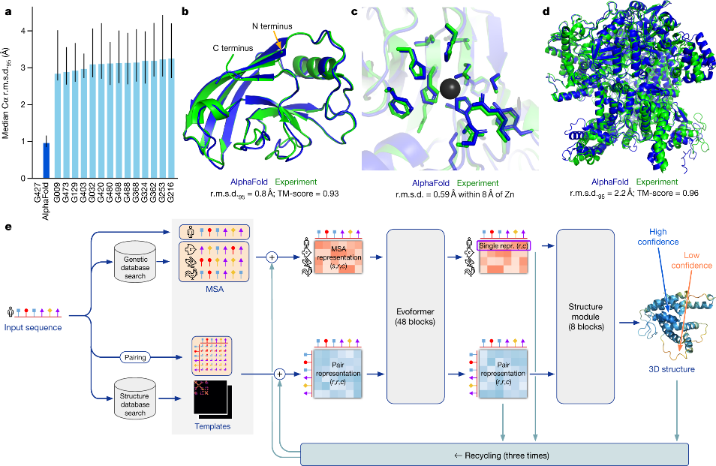
AlphaFold2 A leap forward in computational prediction accuracy
Fig. 1: AlphaFold produces highly accurate structures – from "Highly accurate protein structure prediction with AlphaFold" - Nature, 596, 583-89 (2021).
Improvements
More than 2x as accurate as anyone else​
The global fold reliable when compared to very expensive experiments​
Set the algorithm architecture that is that standard today​

Slide 8
Under the hood..

Slide 9


X'Fold' programs – the way they fold is very strange
No (explicit) Physics or Chemistry
Large Language Models (e.g. GPT) learns context from pure text tokens EvoFormers learns 1D -> 2D -> 3D from sequence and solved structures in Protein Data Bank (PDB)
Supplementary Videos: Ahdritz, G., Bouatta, N., Floristean, C. et al. OpenFold: retraining AlphaFold2 yields new insights into its learning mechanisms and capacity for generalization. Nat Methods 21, 1514–1524 (2024). https://doi.org/10.1038/s41592-024-02272-z
PDB ID: 7RDT
PDB ID: 7B3A

Slide 10
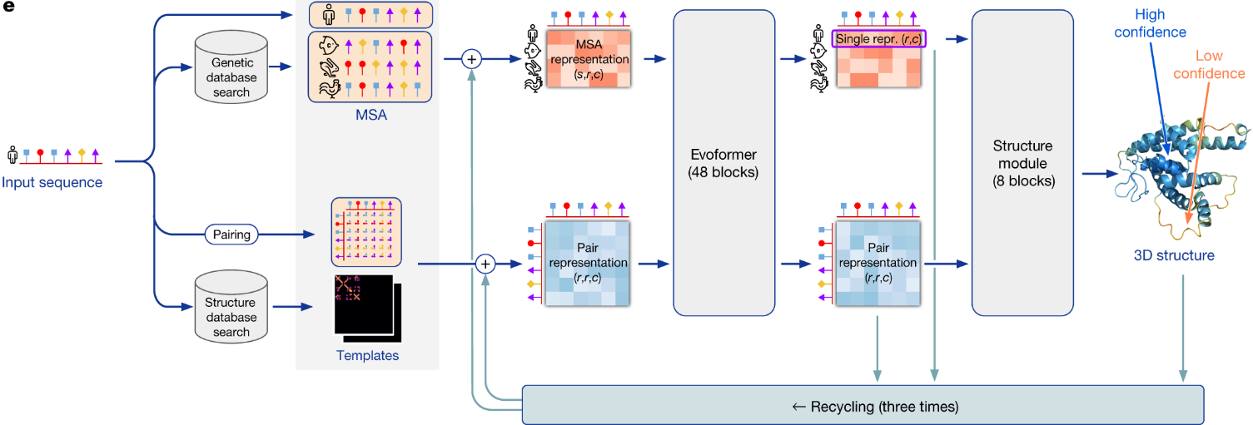
AlphaFold2 architecture ingenious algorithm design made this breakthrough
Spatial relationships
Assemble the amino acid triangles
Slow..
Related species
GPU intensive
Genetic
Preserved across evolution
Related proteins Known residue contacts
Fig. 1: AlphaFold produces highly accurate structures – from "Highly accurate protein structure prediction with AlphaFold" - Nature, 596, 583-89 (2021). ​

Slide 11
Code choice..

Slide 12
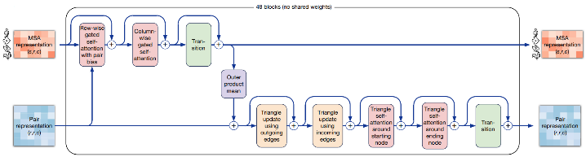
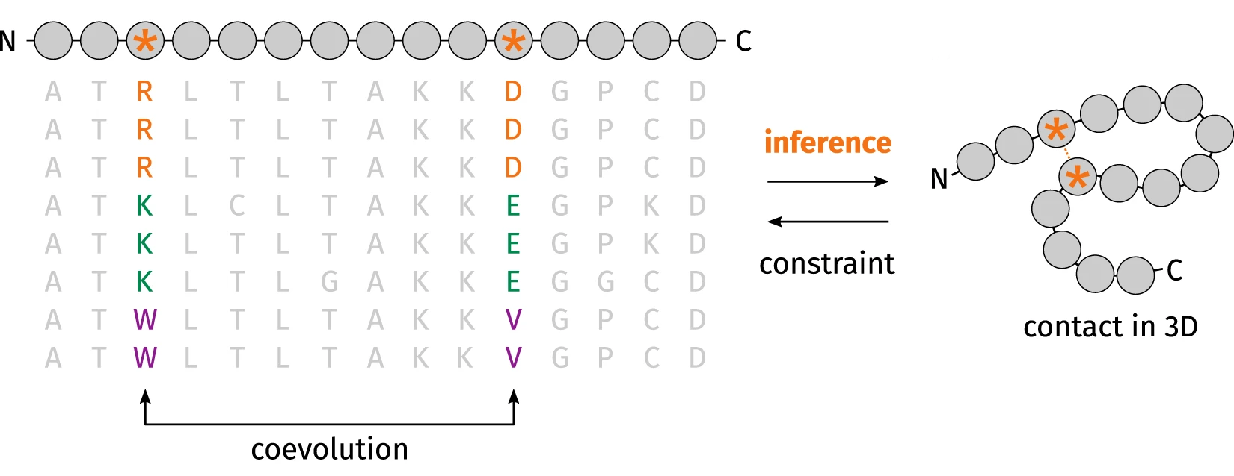
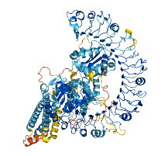
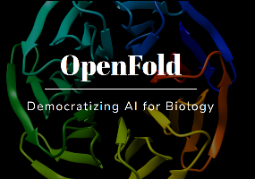
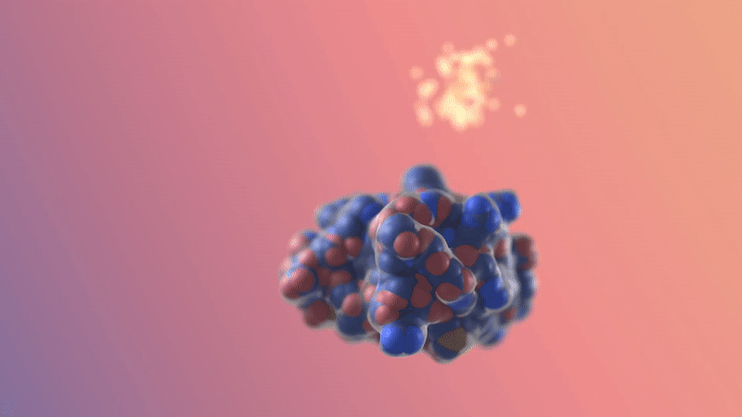
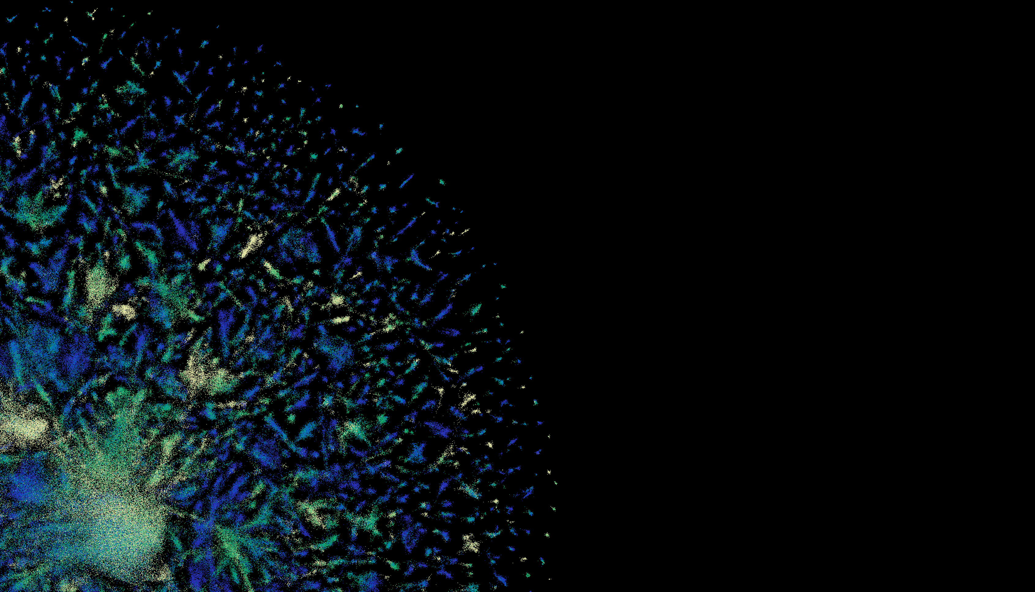


X'Fold' programs - co-evolution DeepLearning
DeepLearning: No folding physics – Transformers – 1D sequence -> 3D structure
High Performance Computing: Not for domestic computers. Use your uni's HPC cluster.
'Evo'formers
Protein-LLMs
GenAI - Diffusion
(Alpha|Open|RoseTTA|Ab)Fold
ESMFold, ProtTrans
RFDiffusion, Chroma

Slide 13

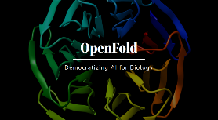






Tutorial only on protein folding - X'Fold' programs
The largest Big Tech and academic groups in world have dedicated serious expertise and resources into developing these programs.
They are mostly free and open source (academic, non-commercial work). If you develop the skills to run the code on local hardware.
https://github.com/google-deepmind/alphafold
https://github.com/google-deepmind/alphafold3
Let's do Biology! Focus on easiest AlphaFold2 method
https://github.com/facebookresearch/esm
https://github.com/aqlaboratory/openfold
https://github.com/bytedance/Protenix
https://github.com/jwohlwend/boltz
https://github.com/sokrypton/ColabFold
https://github.com/baker-laboratory/RoseTTAFold-All-Atom

Slide 14
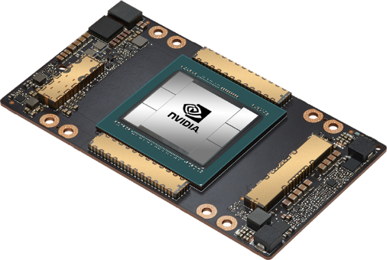
X'Fold' programs – each has its place
Computing is all about trade-offs:
speed ⚔️ accuracy ⚔️ cost
Algorithms are also about hand-offs: 💾Storage 🤝️ 🗃️memory🤝️ 𓇲 Processors 🤝️⌛run time
COMPUTERS ARE FAST
$10,000s a pop in the AI arms race
10s/100s/1,000s structures/day
Programming is all about re-use: Code is crystallized labour that can be run xbillions/second
Researchers adapt & script the last-mile for their usage
The computing stack is also about access: Programmers 🤝 pipetters | customisability ⚔️ease-of-use Data processing ⚔️ restricted graphical interfaces Free & Open Source licences ⚔️ recoup development cost
Let's do Biology! Focus on easiest-to-use AlphaFold2 method

Slide 15
BioTech applications..

Slide 16
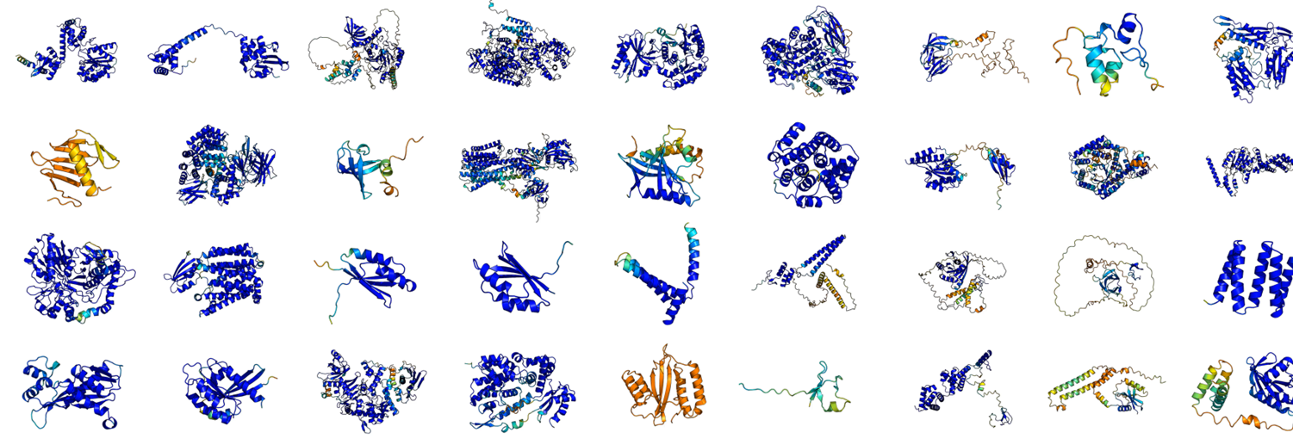

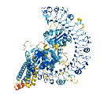

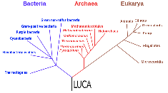

Folding Entire Proteomes Predict a molecular inventory of your organism (my predictions from bioinformatician's closed genome)
A mix of AlphaFold2, ESMFold and AlphaFold3
Sequence genome
Evo-AI methods
Struct search
4544 proteins
4544 structures
AlphaFoldDB

Slide 17
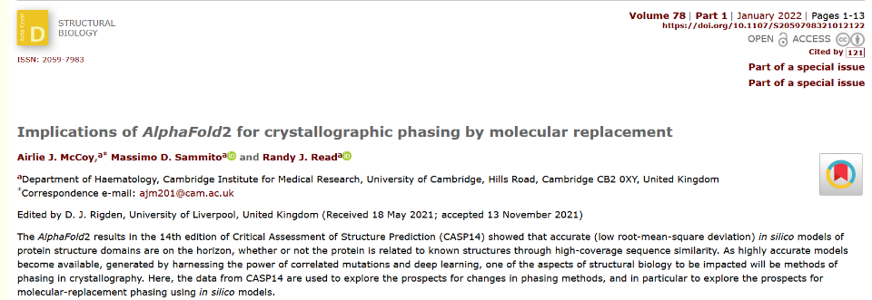
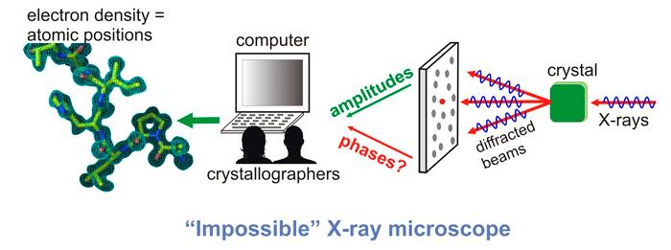
Clarifying Experiments
Using computer models on unsolved structure problems
Source: LibreTexts Chemistry 1.7: Structural Resolution (accessed March 2025)

Slide 18
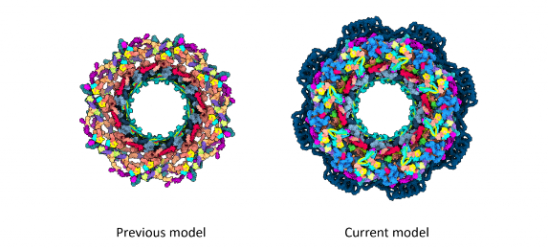
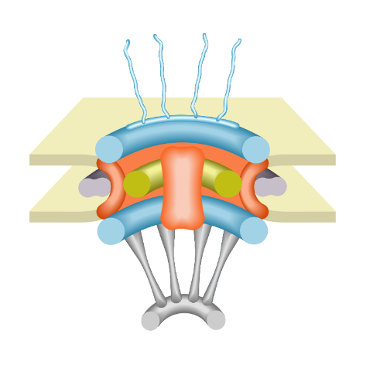
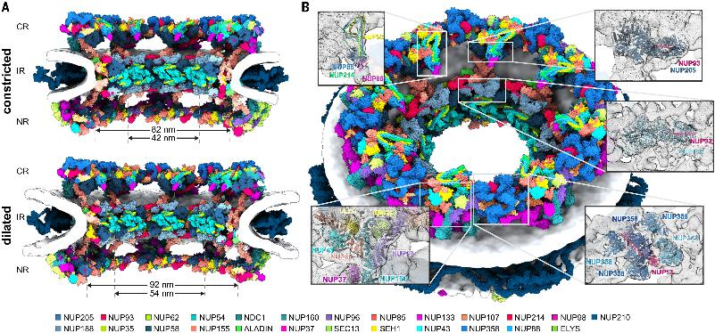
Assembly Building from AlphaFold + Electron Microscopy Building the "monstorous maw"
Nuclear Pore Complex
Source: https://www.embl.org/news/science/puzzling-out-the-structure-of-a-molecular-giant/
Science, Vol 376, Issue 6598, 2022
Transport of large molecules to cell

Slide 19
Accessing software.. and licence restrictions...

Slide 20
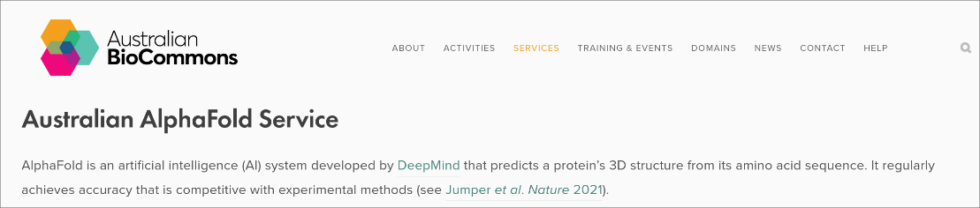
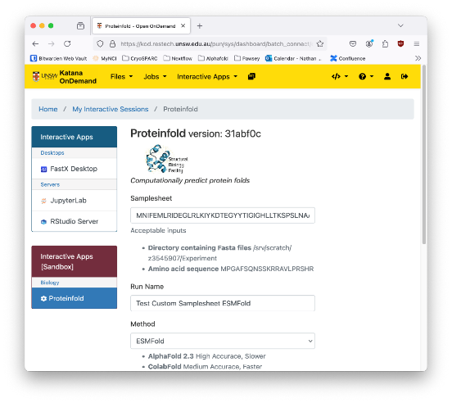
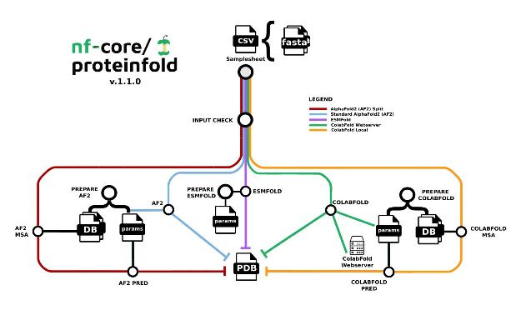
Where to run? Galaxy, Uni compute cluster, proteinfold

Slide 21
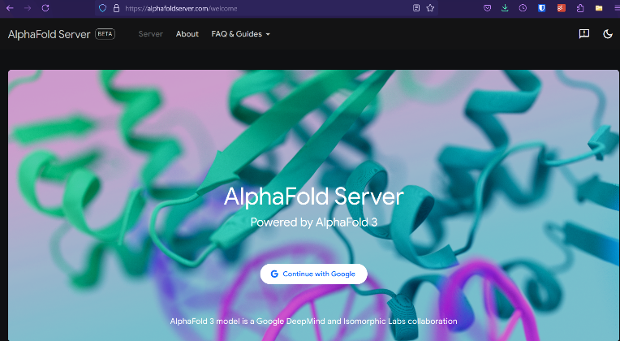
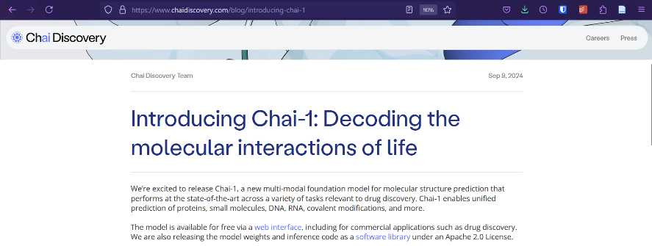
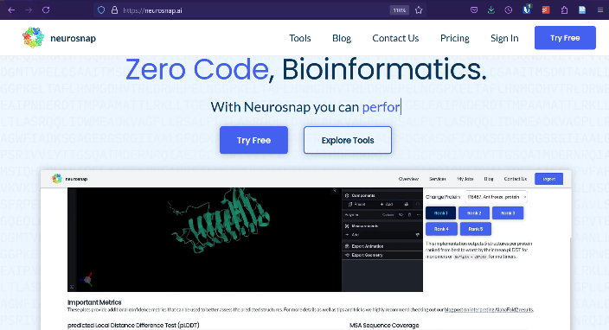
Dedicated web forms - portals built by companies

Slide 22
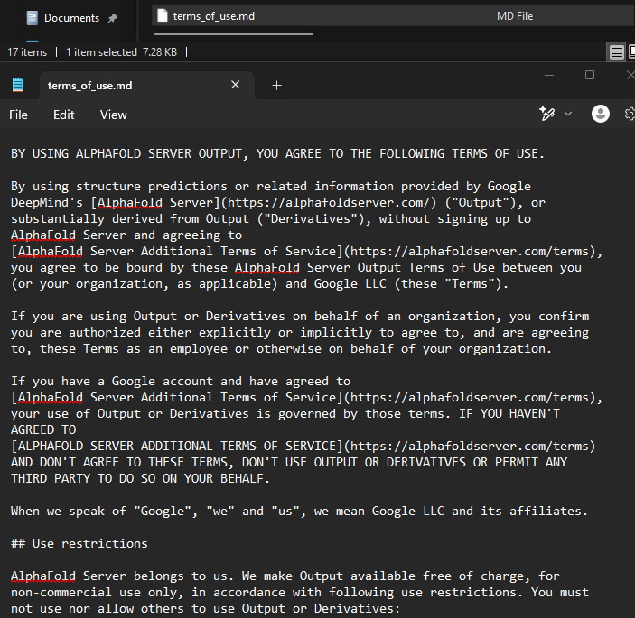
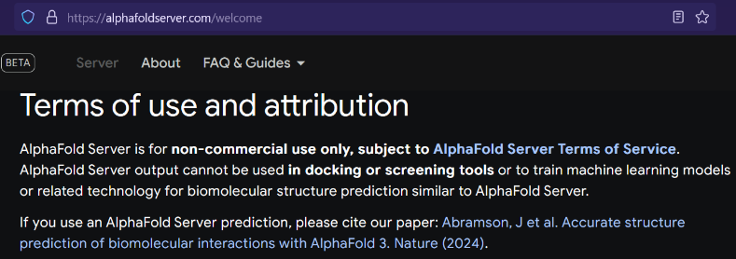
Licensing restrictions Think before you input!

Slide 23
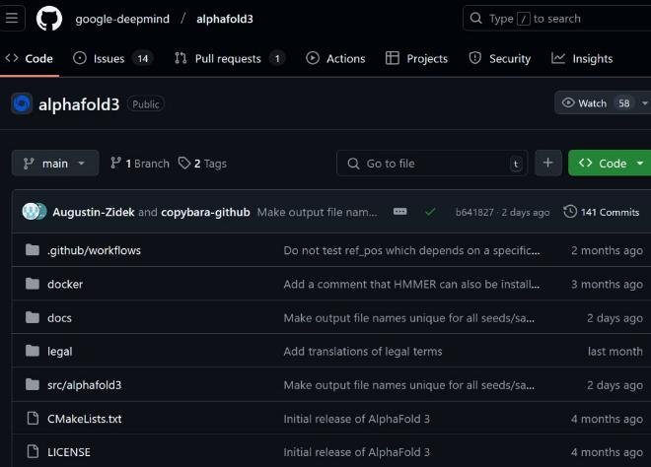
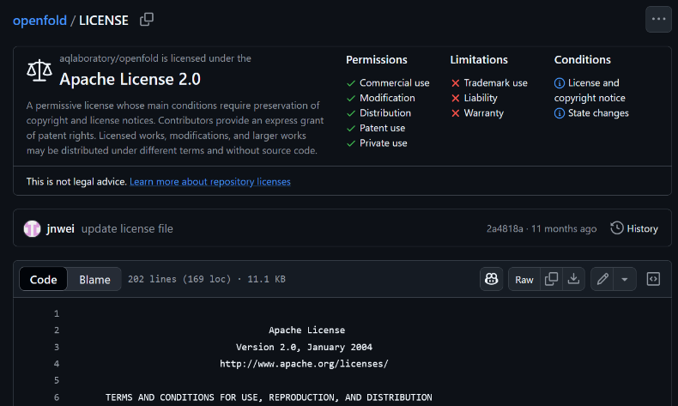
Licensing restrictions find the LICENSE file summary
Restricted
Unrestricted

Slide 24
Break!
💤
Get your laptops ready to run your own structure prediction :)

Slide 25
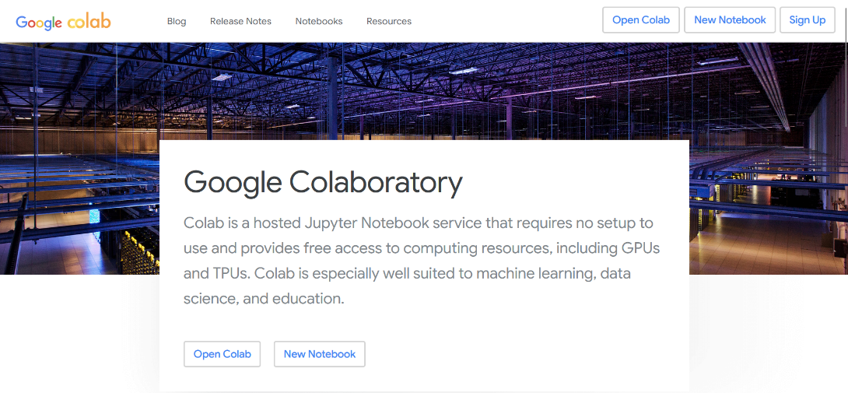

ColabFold – running AlphaFold2 on Colab
https://colab.research.google.com/github/sokrypton/ColabFold/blob/main/AlphaFold2.ipynb

Slide 26
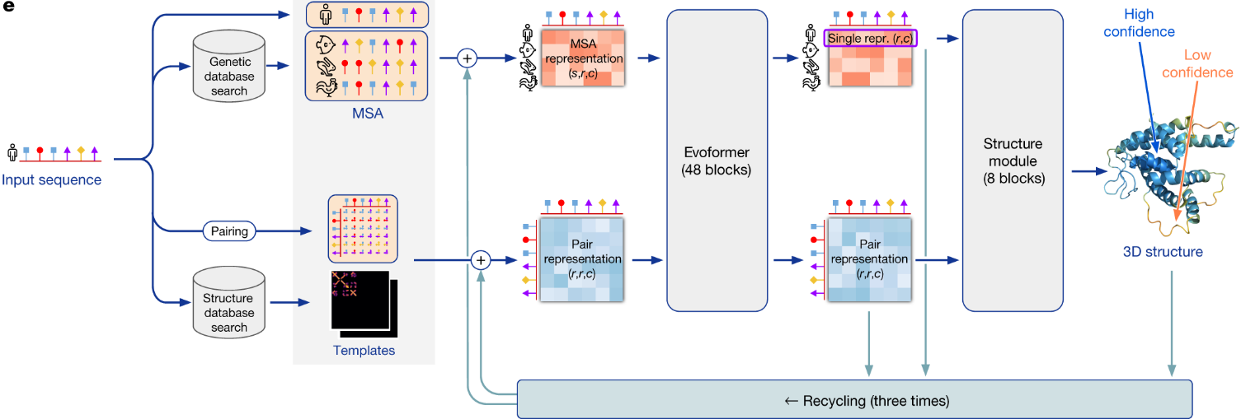
ColabFold – running AlphaFold2 on Colab
https://colab.research.google.com/github/sokrypton/ColabFold/blob/main/AlphaFold2.ipynb
Architecture compared to input_options (mostly default)
msa_mode
model_type
max_msa
pairing_strategy
query_sequence
pair_mode
num_relax
pdb100
template_mode
Fig. 1: AlphaFold produces highly accurate structures – from "Highly accurate protein structure prediction with AlphaFold" - Nature, 596, 583-89 (2021). ​
num_recycles

Slide 27
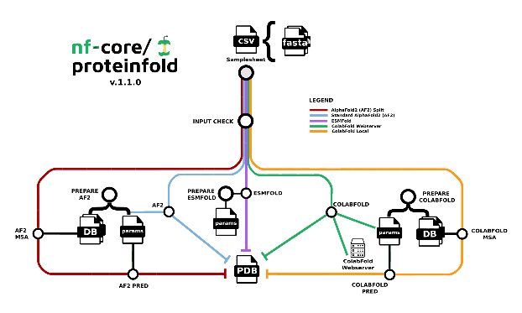
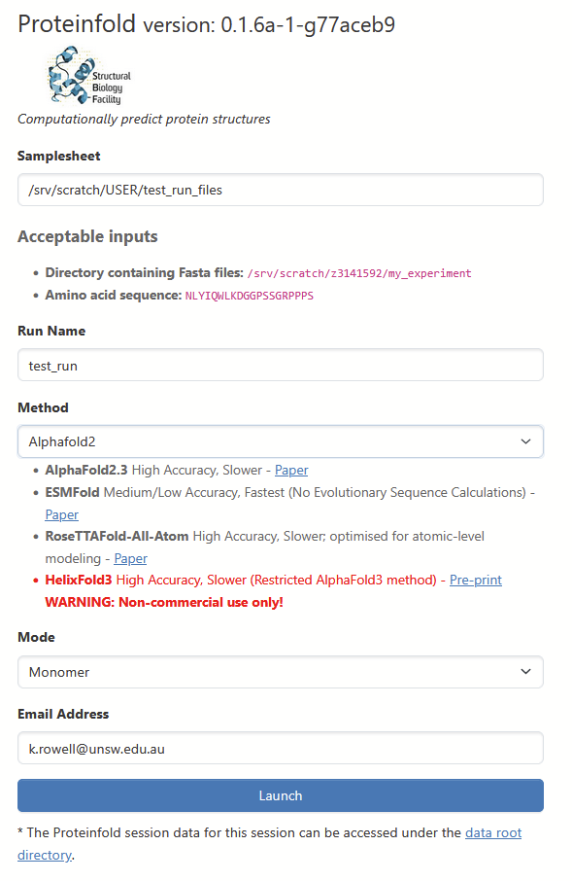
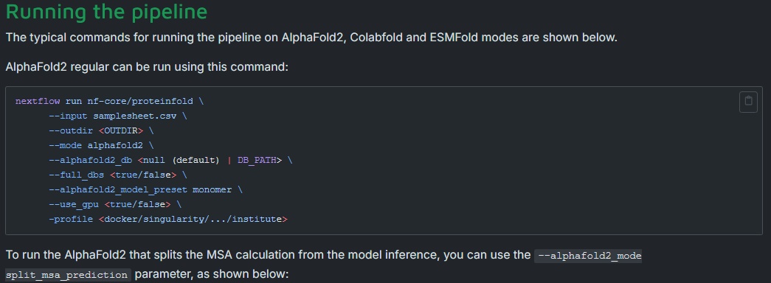
Live Demo – ProteinFold terminal vs Web

Slide 28

Self-learning – spend 3 hrs with the pros!
https://www.ebi.ac.uk/training/online/courses/alphafold/

